Slide 1

Market Opportunities: Asterisk Vodka
***
May 2024
Notes:
https://www.pexels.com/photo/assorted-labeled-bottle-on-brown-shelf-2198400/

Slide 2
Exploratory Marketing Overview
***
Market leader in the refined product marketing and trading space with 30 years in the business
Formed in 1990 by Bob Wright (President & CEO)
2B
7th
$145MM
Total gallons product marketed
Largest private company in DFW area
Line of credit w/ Frost Bank
$3B
30
Annual revenue
Years of continuous business profitability
Business Units include:
Domestic Ethanol
Partner of 10 plants; 960MM marketed gallons; 8% of market including trade bbls
National distribution; sources from every major producer, paid fuel taxes in 42 states
International Ethanol
Market leader with 25-40% of exported volumes from US from 2011-2022
Methanol
Supply Contract with Methanex
~11% of US market
Crude
Refined Products
Large crude by rail presence, marketed 1B barrels in 2019
Origin and destination terminals in Permian and New Orleans
Large export program to Mexico
Focus on regions underserved by rail and pipe
Have sold to 20+ countries; large tank position on the Gulf; largest shipper into Canada

Slide 3
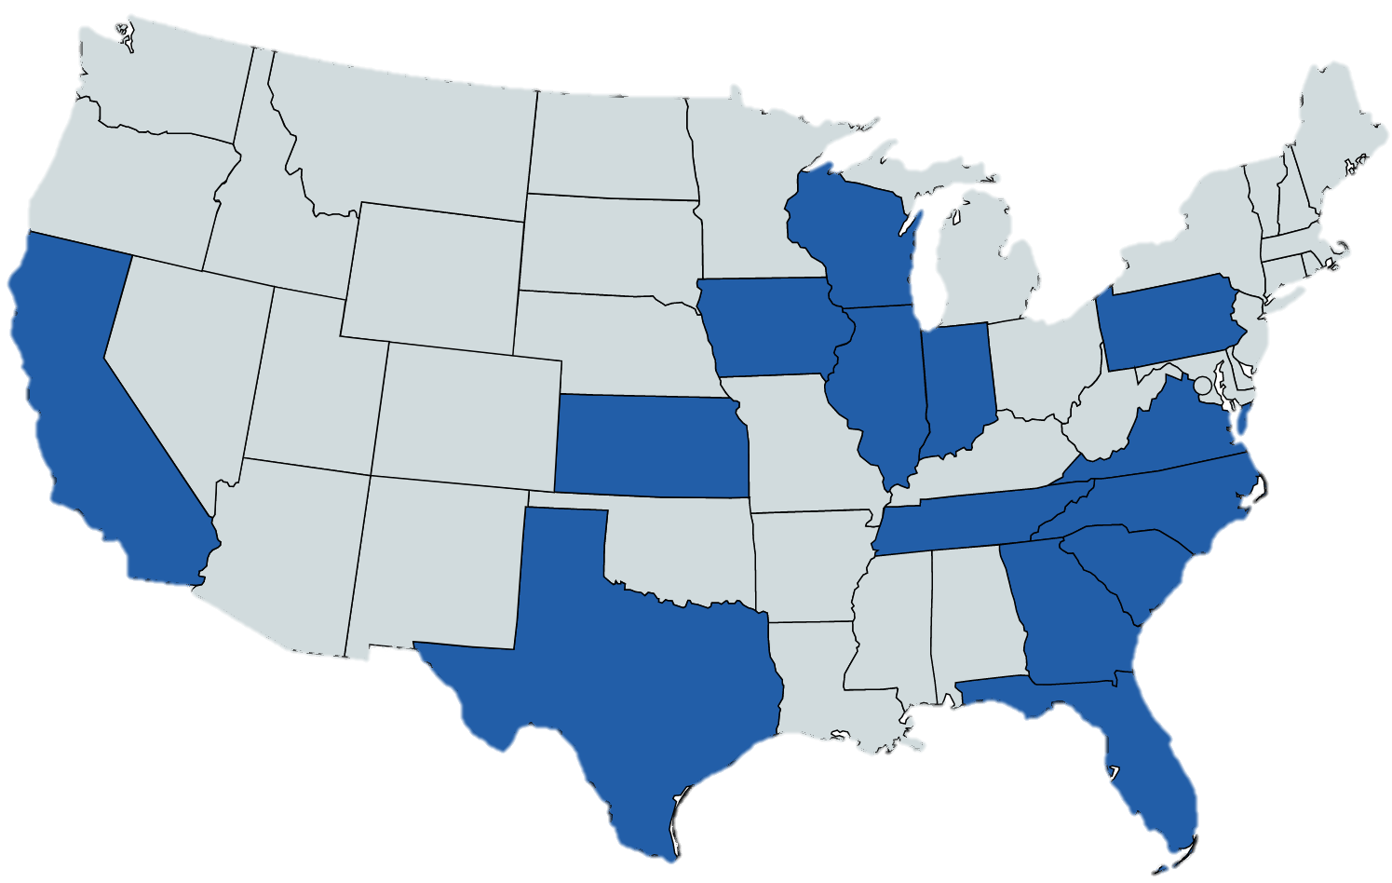




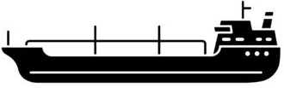
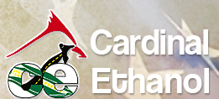



Historical Market
***
Murex leverages scale and carbon market expertise to drive value for ethanol plant partners
Murex, by the numbers:
10 ethanol plants marketed
20+ countries sold to
~22% of annual US ethanol exports
960 MMgals marketed annually
3,800 domestic rail car fleet
Ethanol Plant Partners
Terminals
Transloading

Slide 4
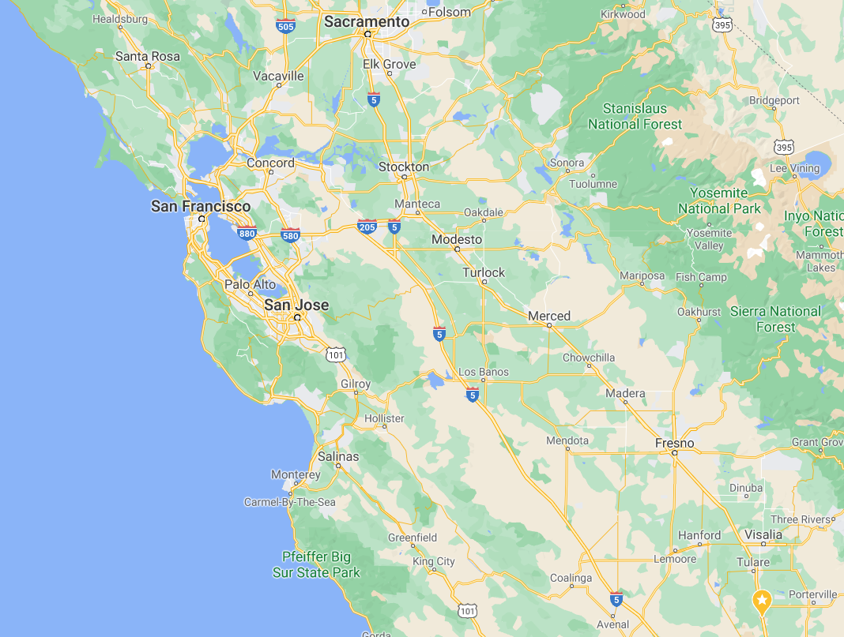
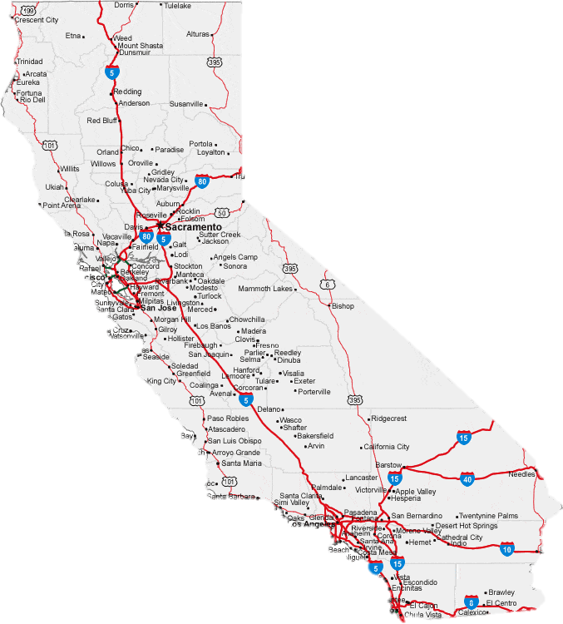
Current Market
***
Domestic Imports
55-65 CI
Low CI imports are incentivized to sell into California even at a reduced price due to LCFS program. Brazilian imports (∆15 CI and D5 RIN) willing to discount up to 20 cpg to secure sales.
Stockton Plant
60MGY; 66 CI
Keyes Plant
60MGY; 67 CI
Active Ethanol Plants
Brazil Imports
45 CI
Seasonal (May-Dec)
Madera Plant
40MGY; 67 CI
Idle Ethanol Plants
Inbound Terminals
Pixley Plant
55MGY; 59 CI
Domestic Imports
55-65 CI
Murex breaks bulk and sells delivered trucks in Northern Cal
Delivered Trains and Manifest into Southern Cal
Nearby shorts contracted to Murex customers due to long-standing Murex relationships
Oversupply looming in domestic industrial ethanol market; may endanger payback on investment
Brazil Imports
45 CI
Seasonal (Apr-Nov)

Slide 5
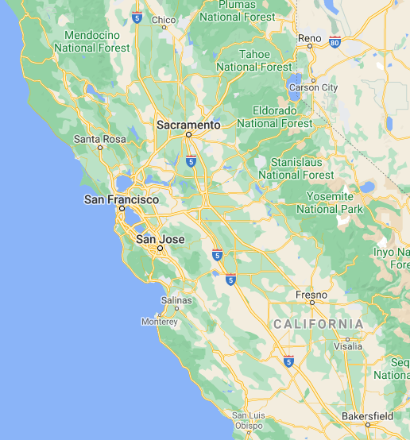
Action Plan: Aemetis Ethanol
***
Leverage California Market Position
Carbon Market Knowledge
Provide Optionality: Fuel
Provide Optionality: Industrial
The Murex Advantage
Murex sells to the majority of shorts near the Aemetis plant
Not due to lower price; due to long-standing relationships and strong operational performance
Murex contracts 225,000 bbls of storage at Nustar Stockton and Selby
Significantly more storage than Kinergy
Selby can be used to provide export optionality for Aemetis fuel and industrial volumes
Allows Murex to compensate for plant outages and provide flow assurance to buyers
Consolidation of Aemetis volumes into Murex’s portfolio would allow:
Reduction of Aemetis trucking costs through optimization of supply to shorts
Increased pricing through walking up margins similar to West Texas case study
Pacific Ethanol
Aemetis
Pacific Ethanol
Ethanol Plants
Calgren
Murex Storage
Murex Shorts

Slide 6
Action Plan: Aemetis Ethanol
***
Leverage California Market Position
Carbon Market Knowledge
Provide Optionality: Fuel
Provide Optionality: Industrial
Murex has in-house expertise in GHG modeling
Model Aemetis operational data against international/domestic carbon programs to determine which would yield the highest price
Murex is an experienced seller into domestic and international carbon markets
Has sold ethanol into 20+ countries; can leverage relationships to secure shorts for Aemetis
Murex has expertise evaluating and recommending carbon projects
Optimize current projects to generate highest netbacks
Then would run economics to determine which market has highest overall netback
Unique access – only company allowed to import into Columbia
Experience in broad range of renewable energy projects including carbon sequestration, wind power, and more
Murex can leverage strong balance sheet and liquidity to maximize profits
Can monetize and maximize value for D3 RINs from Aemetis’s RNG project due to exporter status and balance sheet

Slide 7
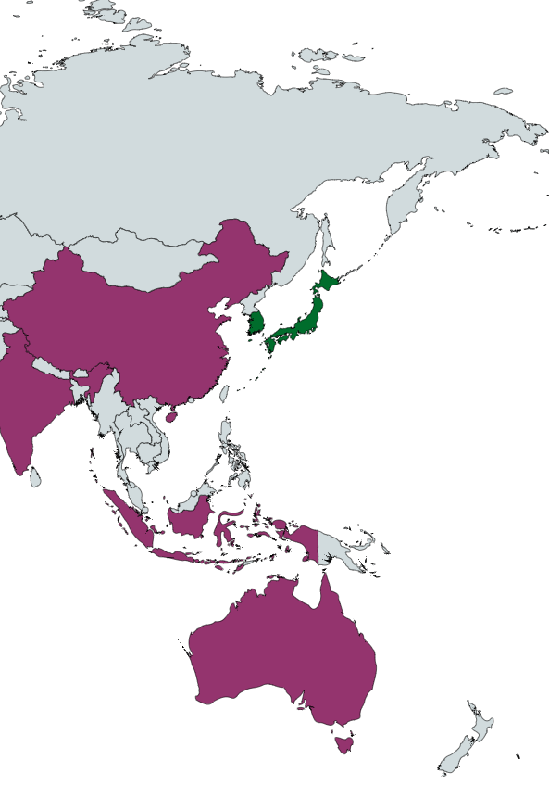
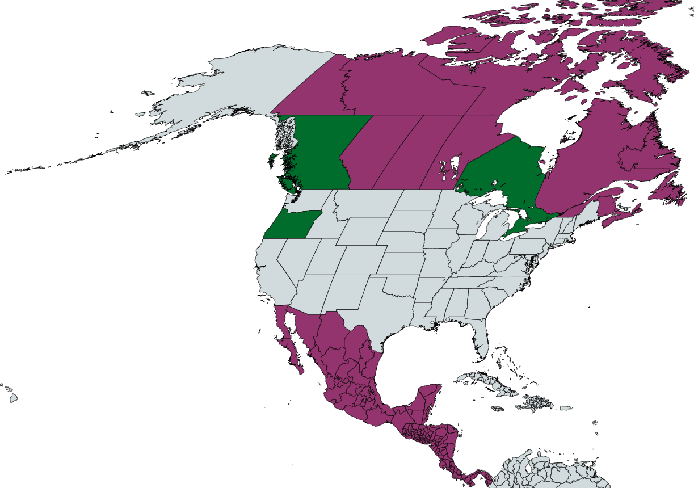
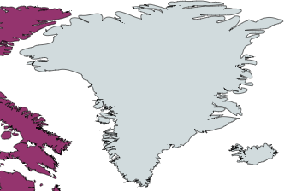
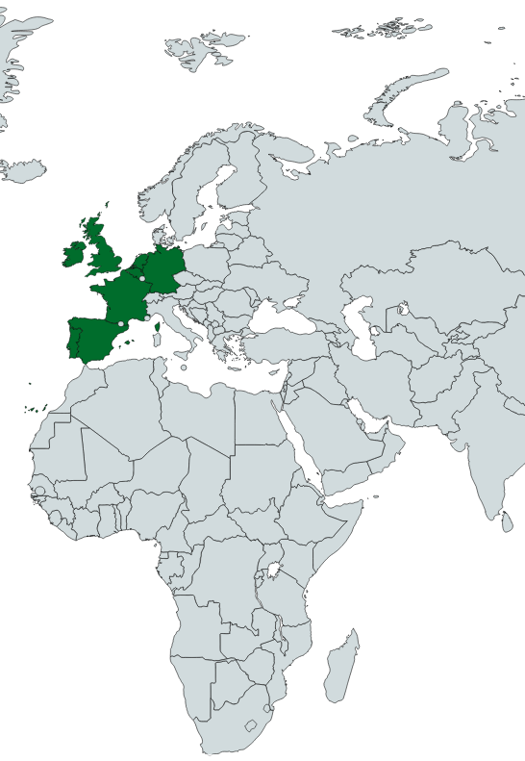
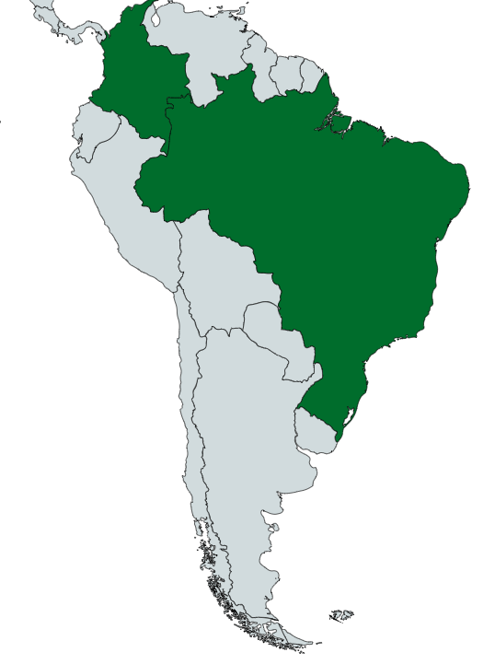
Action Plan: Aemetis Ethanol
***
Leverage California Market Position
Carbon Market Knowledge
Provide Optionality: Fuel
Provide Optionality: Industrial
Premium Export Market
Election Result Dependent
Murex actively sells into multiple low carbon markets that may provide better netbacks now or in the future. May be an alternative to continued low carbon investment to keep up with ethanol plants selling into California market.

Slide 8
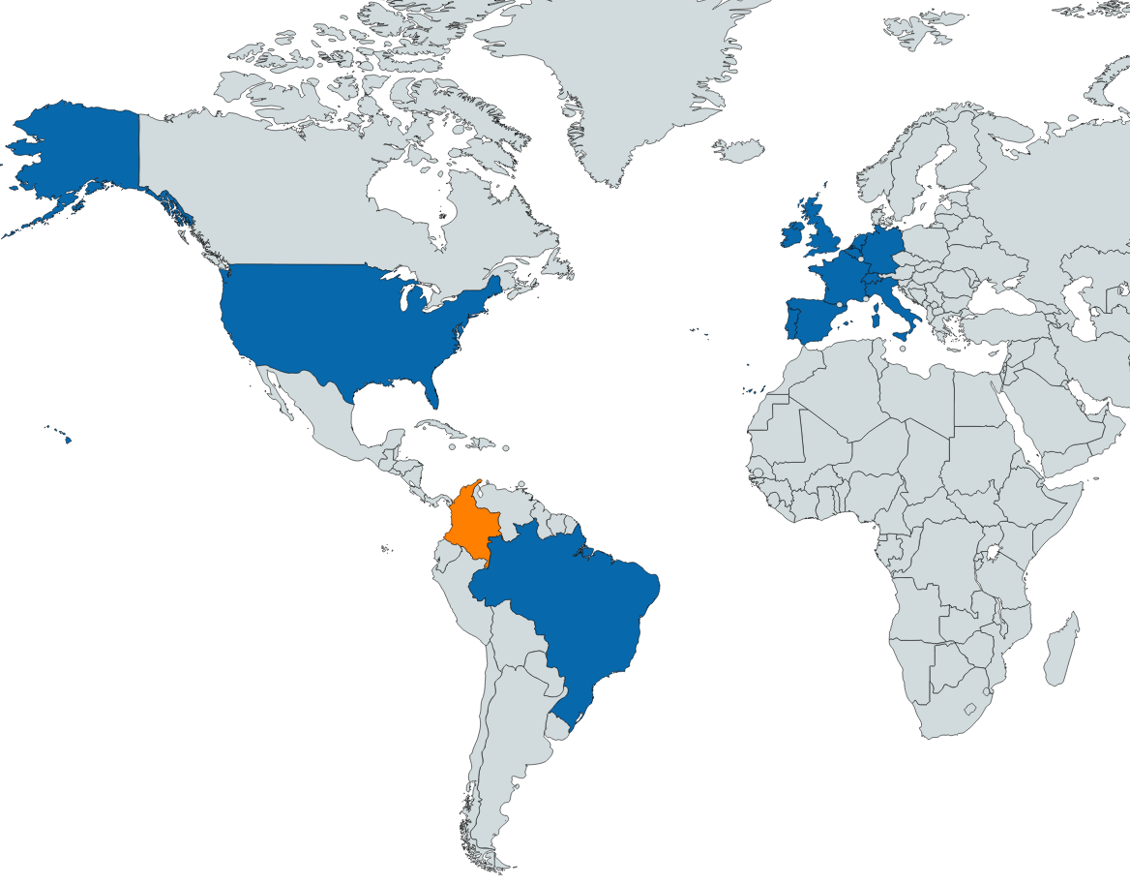
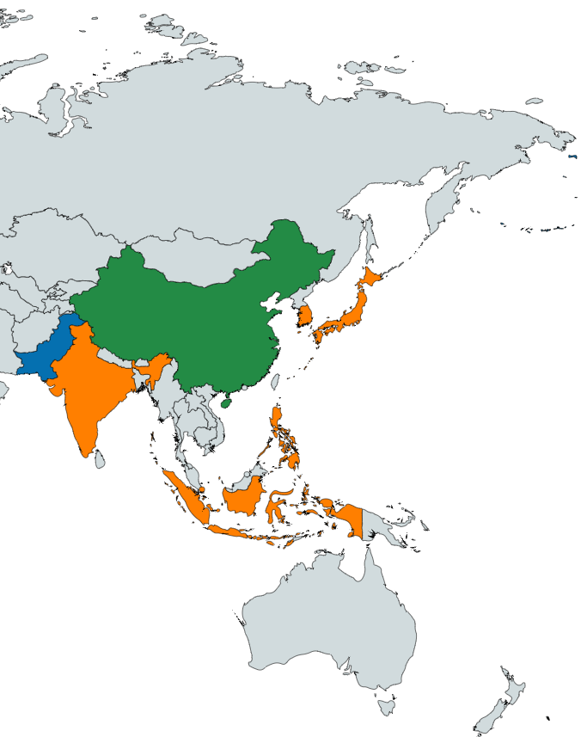
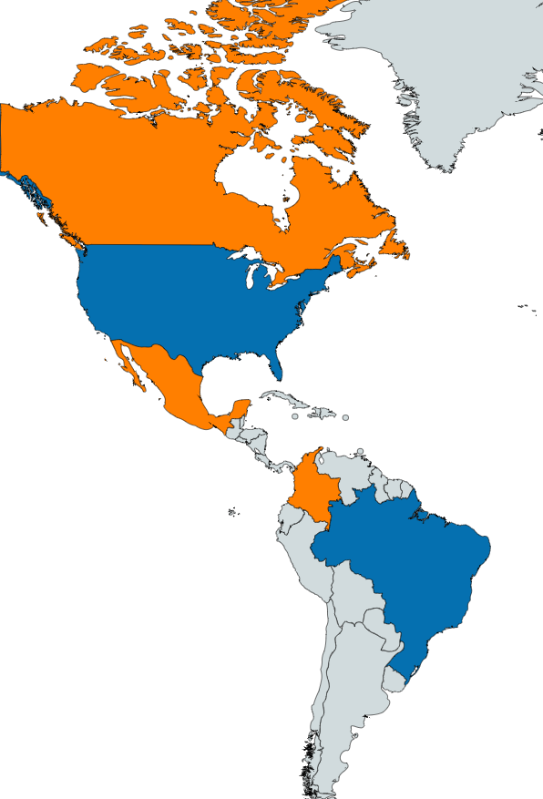
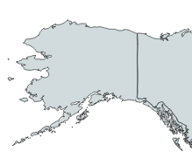
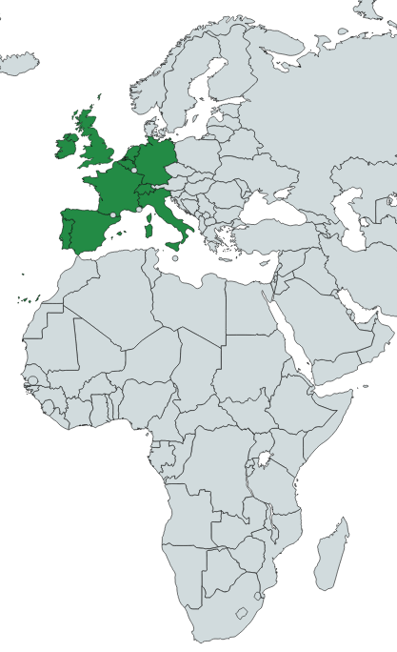
Action Plan: Aemetis Ethanol
***
Leverage California Market Position
Carbon Market Knowledge
Provide Optionality: Fuel
Provide Optionality: Industrial
Canada
Europe
Korea
Europe
China
Japan
United States
Pakistan
United States
India
Mexico
Philippines
Singapore
Net Exporter
Columbia
Indonesia
Columbia
Net Importer
Brazil
Seasonal Import/Export
Brazil
With the surge in domestic USP production, the United States may become oversupplied and return to being a net exporter in the next few years. Murex is capable of exporting to international markets through Selby terminal.

Slide 9
Limitations and Further Research
***
Murex’s trade shop and strong balance sheet provide many services to our customers
Exporting Capability | As a market leading US ethanol exporter, Murex has relationships and shorts around the world.
Operational Focus | 18 employees focused on ethanol logistics and customer service. We’ve had California shorts preferentially buy from Murex due to smooth operations.
Trading/Hedging | Traders have both agriculture and energy markets experience. Routinely execute futures/swaps/hedges across multiple products. We handle Crush related trading for plants, trade spreads, manage inventory hedges.
RINs | Exporter status gives Murex RIN separation capabilities. We help plants Monetize RINs generated from higher blends and can sell to large companies who have restrictions on financials. Can monetize and maximize value for D3 RINs generated from RNG project.
No significant ownership in plants | Do not cherry pick the best sales for our operating assets

